Slide 1





ARVs - Moving to the integrase era
Pedro Cahn

Slide 2

Disclosures
Research grants: Abbvie – Merck – Richmond – ViiV Healthcare
Advisory boards: Merck – ViiV Healthcare
Speaker at educational programs: Abbvie - Merck

Slide 3
Acknowledgements
Jose Arribas
Esteban Burrone
Meg Doherty
Carlos Falistocco
Diane Gibb
Roy Gulick
Reuben Granich
Beatriz Grinjzstejn
Diane Havlir
Salim Abdool Karim
Andrew Hill
Omar Marin
Julio Montaner
Koogie Naidoo
Anton Pozniak
Jonathan Schapiro
Adele Schwartz Benzaken
Kimberley Smith
Omar Sued
Francois Venter
Fundacion Huesped research team
Special recognition to the people living with HIV who have generously participated in all the clinical trials reviewed for this presentation.

Slide 4
Outline
InSTIs in 1st line, why?
InSTIs in switch and 2nd line therapy
InSTIs in mono and dual therapy
Long-acting formulations: Treatment & PrEP
Safety
Special populations
Concerns and data gaps
Access, pricing and programmatic challenges

Slide 5
Efavirenz: Invictus, no longer
InSTIs in 1st line, why?
Raltegravir, superiority at 5 years
Dolutegravir, superiority at 48 weeks
Rilpivirine superiority at 48 weeks
  (pVL < 100.000 copies/mL)
CNS side effects, suicidality *, hypertriglicerydemia
* Mollan KR, et al. Ann Intern Med 2014;161:1–10
Other NNRTIs for first line:
Rilpivirine: Limited to baseline pVL < 100,000 copies/mL
Doravirine: Non-inferior to EFV and DRV/r in phase 3
studies, not licensed so far.

Slide 6
PIs: Slowly phasing out as 1st option for treatment initiation
InSTIs in 1st line, why?
Advantages:
High potency
High genetic barrier
Durability
STR: DRV/c/TAF/FTC
Disavantages:
DDIs: Several. Not to be used with Rifampin.
Tolerability: Regular (GI)
Side effects: Rash (Darunavir), Jaundice (Atazanavir)
Impact on comorbidities: High
Metabolic side effects: Glucose intolerance,
diabetes, hypercholesterolemia, hypertriglyceridemia.
Cardiovascular risk
Associated with preterm delivery?

Slide 7
RAL, EVG, DTG and BIC (in combination with other ARVs) have been approved for the treatment of HIV by the FDA, the EMA, and other agencies
InSTIs in 1st line, why?
InSTIs are listed as the preferred option for treatment-naïve patients in several ARV guidelines, including WHO (2018 update)
This is based on efficacy, rapid viral suppression, tolerability, genetic barrier, CD4 recovery and lower rate of treatment discontinuation.
DTG/RIL approved by FDA and EMA
RAL QD approved by FDA and EMA
2018
BIC/FTC/TAF approved by FDA
2017
EVG/c/FTC/TAF
approved by
FDA and EMA
2015
DTG/ABC/3TC
approved
by FDA and EMA
DTG approved by EMA
2014
DTG approved by FDA
2013
EVG/c/FTC/TDF
approved by EMA
2012
EVG/c/FTC/TDF
approved by FDA
2007
RAL BID approved by FDA and EMA
EACS Guidelines Version 9.0, October 2016; . Accessed May 2018.
DHHS Guidelines for the use of antiretroviral agents in HIV-1-infected adults and adolescents, Available fromhttps://aidsinfo.nih.gov/guidelines/html/1/adult-and-adolescent-arv/11/what-to-startBritish HIV guidelines. Accessed may 2018 http://
WHO. Consolidated guidelines on the use of ARV drugs for treating and preventing HIV infection, Available from: http://apps.who.int/iris/bitstream/10665/ 208825/1/9789241549684_eng.pdf. Accessed May 2018.
1. FDA-Approved HIV Medicines. https://aidsinfo.nih.gov/understanding-hiv-aids/fact-sheets/21/58/fda-approved-hiv-medicines. Accessed August 2017;
2. European public assessment reports. http://www.ema.europa.eu/ema/. Accessed October 2017; 3. Tsiang et al. Antimicrob Agents Chemother 2016;60:7086–97; 4. Gilead Press Release June 2017. http://www.gilead.com/news/press-releases/2017/6/gilead-submits-new-drug-
application-to-us-food-and-drug-administration-for-fixeddose-combination-of-bictegravir-emtricitabine-and-tenofovir-alafenamide-for-hiv-treatment. Accessed August 2017.

Slide 8
InSTIs Exhibit Higher Antiviral Activity vs Other Drug Classes
InSTIs in 1st line, why?
PoC ART monotherapy: maximum change in HIV RNA (log₁₀) over 7–14 days
¹⁸
¹
²
³
^{4‡}
⁵
⁶
^{7§}
⁸
¹¹
¹²
¹³
¹⁴
¹⁵
¹⁶
¹⁷
¹⁹
²⁰
^{9**}
^{10‡}
²¹
300 mg BID
InSTIs:
Also active
against HIV-2
25 mg QD
40 mg QD
200 mg QD
50 mg QD
30 mg QD
40 mg QD
300 mg BID
600 mg BID
600 mg BID
100 mg QD
300 mg BID
900 mg BID
500 mg QD
300 mg QD
50/100 mg QD
100 mg BID
600/100 mg BID
1200 mg /100 mg Q12H
200/100 mg or 400/100 BID
10 mg single-dose
Maximum HIV RNA reduction (Log₁₀)†
NNRTIs
PIs
NRTIs
InSTIss
MIs
AI
EIs
Gruzdev et al. AIDS 2003;17:2487-2494.
Goebel et al. AIDS 2006;20:1721-1726.
Murphy et al. AIDS 2001;15(1):F1-F9.
Arasteh et al. AIDS 2005;19:943-947.
BMS Clinical Study Report AI424007, August 2002.
Eron et al. N Engl J Med 1995;333:1662-9.
Ruane et al. Pharmacother 2004;24(3):307-312.
Staszewski et al. AIDS 1998;12:F197-F202
Louie et al. AIDS 2003;17:1151-1156.
Ruane et al. J Acquir Immune Defic Syndr 2013;63:449-455
Friedman et al. CROI 2016, abstract 437LB.
.12. Rousseau et al. The Journal of Infectious Diseases 2003;188:1652-8
13.Markowitz et al. J Acquir Immune Defic Syndr 2006;43:509-515.
14.Min et al. AIDS 2011;25:1737-1745.
15.De Jesus et al. J Acquir Immune Defic Syndr 2006;43:1-5.
16.Spreen et al. HIV Clin Trials 2013;14(5):192-203.
17.Gallant et al. J Acquir Immune Defic Syndr 2017;75:61-66.
18.Hwang et al. Clin Infect Dis 2017;65(3):442-452.
19.Nettles et al. JID 2012;206:1002-11.
20.Fatkenheuer et al. Nature Medicine 2005;11(11):1170-1172.
21.Kilby et al. Nature Medicine 1998;4(11):1302-1307.
Notes:
References
Gruzdev et al. AIDS 2003;17:2487-2494.
Goebel et al. AIDS 2006;20:1721-1726.
Murphy et al. AIDS 2001;15(1):F1-F9.
Arasteh et al. AIDS 2005;19:943-947.
BMS Clinical Study Report AI424007, August 2002.
Eron et al. N Engl J Med 1995;333:1662-9.
Ruane et al. Pharmacother 2004;24(3):307-312.
Staszewski et al. AIDS 1998;12:F197-F202
Louie et al. AIDS 2003;17:1151-1156.
Ruane et al. J Acquir Immune Defic Syndr 2013;63:449-455.
Friedman et al. CROI 2016, abstract 437LB.
Rousseau et al. The Journal of Infectious Diseases 2003;188:1652-8.
Markowitz et al. J Acquir Immune Defic Syndr 2006;43:509-515.
Min et al. AIDS 2011;25:1737-1745.
De Jesus et al. J Acquir Immune Defic Syndr 2006;43:1-5.
Spreen et al. HIV Clin Trials 2013;14(5):192-203.
Gallant et al. J Acquir Immune Defic Syndr 2017;75:61-66.
Hwang et al. Clin Infect Dis 2017;65(3):442-452.
Nettles et al. JID 2012;206:1002-11.
Fatkenheuer et al. Nature Medicine 2005;11(11):1170-1172.
Kilby et al. Nature Medicine 1998;4(11):1302-1307.

Slide 9
Clinical Trials in Treatment-naive Patients: InSTIs Non-inferior or Superior
InSTIs in 1st line, why?
Raltegravir
  Non-inferior to TDF/FTC/EFV at 48 weeks, superior at 5 years (STARTMRK)
  Equivalent to atazanavir/r and darunavir/r at 96 weeks (ARDENT- ACTG 5257)
  QD dosing available, non-inferior to RAL BID (ONCEMRK)
Elvitegravir (STR available with FTC and TDF or TAF)
  Non- inferior to TDF/FTC/EFV or to atazanavir/r at 48 weeks (Gilead 102,103)
  Superior to atazanavir/r in women (WAVES)
Dolutegravir (STR available with 3TC and ABC)
  Non inferior to raltegravir at 48 weeks (Spring-2)
  Superior to TDF/FTC/EFV at 48 and 96 weeks (Single)
  Superior to darunavir/r at 48 and 96 weeks (Flamingo)
  Superior to atazanavir/r in women (ARIA)
  Bictegravir: (STR available with FTC and TAF)
  Non inferior to dolutegravir (GS-US-380-1489 and 1490)
Rockstroh, JAIDS, 2013; Landovitz, CROI 2014; Elion CROI 2013; De Jesus, CROI; 2013; Raffi, Lancet, 2013; Walmsley NEJM, 2013, Clotet, Lancet, 2014 Lancet HIV. 2017 Dec;4(12):e536-e546.. Gallant: Lancet. 2017 Nov 4;390(10107):2063-2072; Sax: Lancet. 2017 Nov 4;390(10107):2073-2082

Slide 10
Successful Switch From Boosted PIs in Suppressed Patients
InSTIs in switch
DTG: Randomized, open-label phase IV study in patients receiving PI/RTV + 2 NRTIs, no resistance, and no VF continued baseline ART through 48 wks or immediately switched to DTG + 2 NRTIs (N = 415)
BIC: Randomized, open-label phase III trial in patients receiving boosted DRV or ATV + 2 NRTIs (ABC/3TC or FTC/TDF) continued baseline ART or switched to BIC/FTC/TAF (N = 577)
No treatment-emergent resistance, lipid parameters significantly improved, median eGFR decreased with switch
Virologic Efficacy, Wk 48
Virologic Efficacy, Wk 48
100
93.1
95.2
100
92.1
88.9
DTG + 2 NRTIs (n = 205)
PI/RTV + 2 NRTIs (n = 210)
BIC/FTC/TAF (n = 290)
80
80
Baseline ART (n = 287)
60
Switch noninferior by primary efficacy endpoint (HIV-1 RNA
< 50 c/mL) treatment difference:
-2.1% (95% CI: -6.6% to 2.4%)
60
  Switch noninferior by primary endpoint (HIV-1 RNA ≥ 50 c/mL) treatment difference:
  0% (95% CI: -2.5% to 2.5%)
ITT Population (%)
Pts (%)
40
40
20
20
2.0
0.5
4.9
4.4
1.7
1.7
6.2
9.4
0
0
HIV-1 RNA < 50 c/mL
Virologic Nonresponse
No Data
HIV-1 RNA
< 50 c/mL
HIV-1 RNA ≥ 50 c/mL
No Data
Gatell JM, et al. AIDS. 2017;31:2503-2514
Daar E, et al. IDWeek 2017. Abstract LB-4.
Notes:
AE, adverse event; BL, baseline; CV, cardiovascular; d/c, discontinuation; DTG, dolutegravir; HDL-C, high density lipoprotein cholesterol; ITT, intent to treat; LDL-C, low density lipoprotein cholesterol; RTV, ritonavir; TC, total cholesterol; TG, triglycerides; VF, virologic failure.

Slide 11
DTG outperforms LPV/R as 2nd line Regimens after NNRTI- based failure
Snapshot Outcomes at Week 24 (Dawning study)
InSTIs in 2nd line
  Virologic outcomes
  Treatment differences (95% CI)
LPV/RTV
DTG
Patients who switched their NRTIs at randomization showed the highest rates of HIV RNA suppression
7.3
20.3
ITT-E
8.1
21.0
PP
DTG + 2 NRTIs is superior to LPV/RTV + 2 NRTIs with respect to snapshot in the ITT-E (<50 c/mL) at Week 24, P<0.001
CI, confidence interval; ITT-E, intent-to-treat exposed; PP, per protocol.
Translation of the study results require caution as investigator-selected NRTIs had to include at least one fully active NRTI based on viral resistance testing at screening.
Aboud et al. IAS 2017; Paris, France. Slides TUAB0105LB.

Slide 12

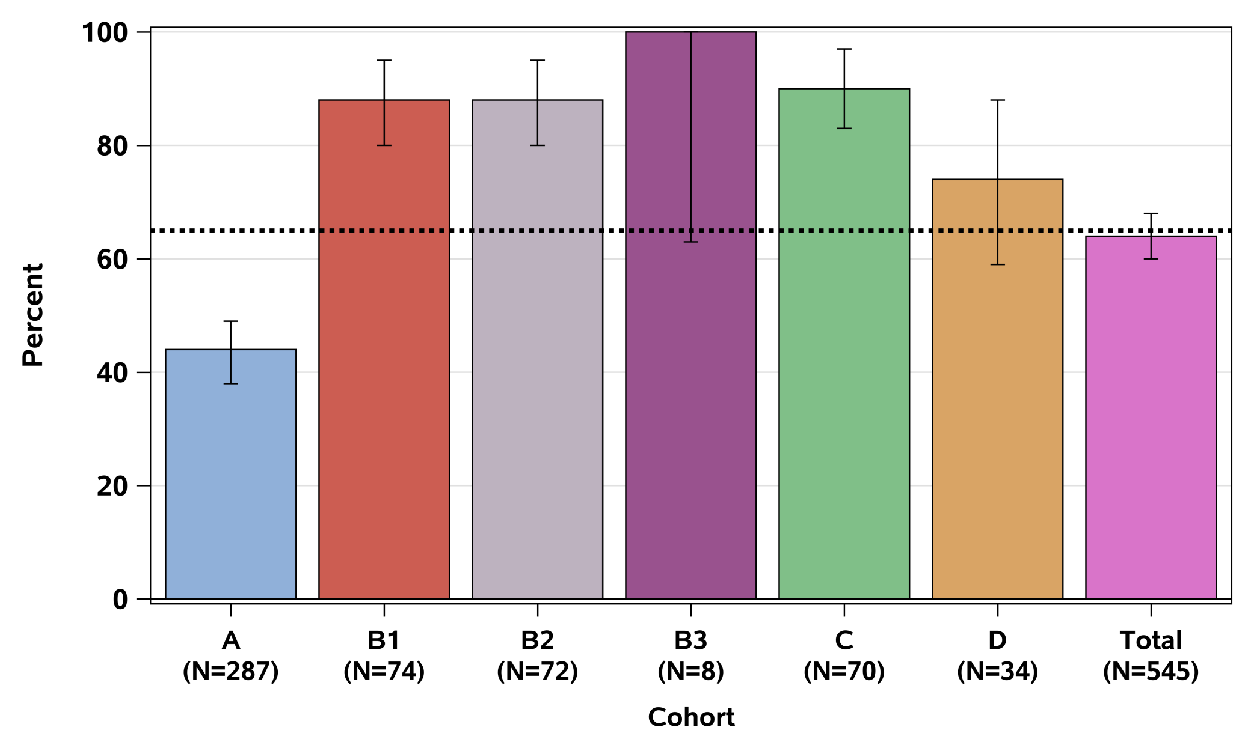
InSTIs in 3rd line
ACTG 5288 - 3rd line ART in RLS based on RAL+ DRV/r + NRTIs: 74 to 100% achieved HIV-1 RNA ≤ 200 copies/mL at 48 weeks
100
80
No LPV/r resistance;` Susceptible to ≥1 NRTI
60
Resistant
to LPV/r;
susceptible
to ETR
Resistant
to LPV/r;
susceptible
to ETR
Resistant to LPV/r & ETR
RAL,
DRV/r &
TDF/FTC
Percent (%)
Resistant
to LPV/r;
susceptible
to ETR
40
ETR,
DRV/r
& RAL
Best available
NRTIs,
DRV/r &
RAL
Not eligible
for Cohorts
A, B, or C
Continue
2nd line ART
Best available NRTIs, RAL & DRV/r
Total
20
44%
88%
88%
100%
90%
74%
64%
0
A
(N=287)
B1
(N=74)
B2
(N=72)
B3
(N=8)
C
(N=74)
D
(N=74)
Total
(N=545)
Grinjztejn B:
CROI 2018, Abstr 30 LB

Slide 13
What about InSTIs monotherapy?
Mono & dual therapy
Only tested with DTG
Mixed results in regards to efficacy
High rate of resistance selection in the integrase gene in case of VF
Resistance mutations selected: 92Q; 97A; 118R; 140S; 148 K, R, H; 155H; 230R; 263K, among others 1,2.
DTG monotherapy should not be used for initial therapy or as a simplification strategy
1. Wensing A et al: Topics in Antiviral Medicine (IAS-USA), 2017
2 . Blanco Jl et al:Curr Opin Infect Dis 2018

Slide 14
Dual Therapy:
Potential InSTI-Based Regimens for Initial/Maintenance Therapy
Mono & dual therapy
Regimen | Treatment Setting | Studies
DTG + 3TC | Initial | PADDLE (open-label phase IV) ACTG A5353 (phase II) GEMINI 1/2 (randomized phase III)
 | Maintenance | ASPIRE (randomized phase III)
DTG + RPV | Maintenance | SWORD 1/2* (randomized phase III)
DTG + DRV/RTV | Maintenance | DUALIS (randomized phase III)
DTG + ATV/RTV | Maintenance | DOLATAV (phase II)
DTG + MVC | Maintenance | HP-00056162 (single-arm phase III)
RAL + ETR | Maintenance | ETRARAL
Notes:
3TC, lamivudine; ATV, atazanavir; DRV, darunavir; DTG, dolutegravir; MVC, maraviroc; RTV, ritonavir.
References:
1. ClinicalTrials.gov. NCT02429791.
2. ClinicalTrials.gov. NCT02422797.
3. Llibre JM, et al. CROI 2017. Abstract 44LB.
4. ClinicalTrials.gov. NCT02831673.
5. ClinicalTrials.gov. NCT02831764.
6. ClinicalTrials.gov. NCT02211482.
7. Cahn P, et al. IAC 2016. Abstract FRAB0104LB.
8. Taiwo BO, et al. IAS 2017. Abstract MOAB0107LB.
9. ClinicalTrials.gov. NCT02263326.
10. ClinicalTrials.gov. NCT02486133.
11. ClinicalTrials.gov. NCT02542852.
12. ClinicalTrials.gov. NCT01896921.
We are going to look at some studies examining dolutegravir-based regimens. We will certainly look at the SWORD study, which is a phase III trial of maintenance therapy. There are studies of dolutegravir plus 3TC both as initial therapy and as maintenance. And then there are studies of dolutegravir plus darunavir, dolutegravir plus atazanavir, and last but not least, dolutegravir plus maraviroc.

Slide 15
Mono & dual therapy
#W96 | SCR | BSL | DAY 4 | DAY 7 | W.2 | W.3 | W.4 | W.6 | W.8 | W.12 | W.24 | W.36 | W.48 | W 96
1 | 5.584 | 10.909 | 383 | 101 | < 50 | < 50 | < 50 | < 50 | < 50 | < 50 | < 50 | < 50 | < 50 | < 50
2 | 8.887 | 10.233 | 318 | < 50 | < 50 | < 50 | < 50 | < 50 | < 50 | < 50 | < 50 | < 50 | < 50 | < 50
3 | 67.335 | 151.569 | 1.565 | 1.178 | 97 | 53 | < 50 | < 50 | < 50 | < 50 | < 50 | < 50 | < 50 | < 50
4 | 99.291 | 148.370 | 3.303 | 432 | 178 | 55 | < 50 | < 50 | < 50 | < 50 | < 50 | < 50 | < 50 | < 50
5 | 34.362 | 20.544 | 1.292 | 570 | 107 | < 50 | < 50 | < 50 | < 50 | < 50 | < 50 | < 50 | < 50 | < 50
6 | 16.024 | 14.499 | 1.634 | 162 | < 50 | < 50 | < 50 | < 50 | < 50 | < 50 | < 50 | < 50 | < 50 | < 50
7 | 37.604 | 18.597 | 819 | 61 | < 50 | < 50 | < 50 | < 50 | < 50 | < 50 | < 50 | < 50 | < 50 | < 50
8 | 25.071 | 24.368 | 1.377 | Not done | 105 | < 50 | < 50 | < 50 | < 50 | < 50 | < 50 | < 50 | < 50 | < 50
9 | 14.707 | 10.832 | 516 | 202 | < 50 | < 50 | < 50 | < 50 | < 50 | < 50 | < 50 | SAE
10 | 10.679 | 7.978 | 318 | < 50 | < 50 | < 50 | < 50 | < 50 | < 50 | < 50 | < 50 | < 50 | < 50 | <50
11 | 50.089 | 273.676 | 68.129 | 3.880 | 784 | 290 | 288 | 147 | < 50 | < 50 | < 50 | < 50 | < 50 | 70/<50*
12 | 13.508 | 64.103 | 3.296 | 135 | 351 | 84 | 67 | < 50 | < 50 | < 50 | < 50 | < 50 | < 50 | < 50
13 | 28.093 | 33.829 | 26.343 | 539 | 61 | < 50 | < 50 | < 50 | < 50 | < 50 | < 50 | < 50 | < 50 | < 50
14 | 15.348 | 15.151 | 791 | 198 | < 50 | 61 | 64 | < 50 | < 50 | < 50 | < 50 | < 50 | < 50 | < 50
15 | 23.185 | 23.500 | 4.217 | 192 | < 50 | < 50 | < 50 | Not done | < 50 | < 50 | < 50 | < 50 | < 50 | < 50
16 | 11.377 | 3.910 | 97 | 143 | < 50 | < 50 | < 50 | < 50 | < 50 | < 50 | < 50 | < 50 | < 50 | < 50
17 | 39.100 | 25.828 | 1.970 | 460 | 52 | < 50 | < 50 | < 50 | < 50 | < 50 | < 50 | < 50 | < 50 | < 50
18 | 60.771 | 73.069 | 2.174 | 692 | 156 | < 50 | < 50 | < 50 | < 50 | < 50 | < 50 | < 50 | < 50 | < 50
19 | 82.803 | 106.320 | 2.902 | 897 | 168 | 76 | < 50 | < 50 | < 50 | < 50 | < 50 | PDVF
20 | 5.190 | 7.368 | 147 | 56 | < 50 | < 50 | < 50 | < 50 | < 50 | < 50 | < 50 | < 50 | < 50 | <50
Virologic Outcome at Wk 24, n (%) [Primary endpoint] | Baseline HIV-1 RNA, copies/mL |  | Total (N = 120)
 | > 100,000 (n = 37) | ≤ 100,000 (n = 83)
Success (pVL<50 copies/mL) | 33 (89) | 75 (90) | 108 (90)
Nonsuccess | 3 (8) | 2 (2) | 5 (4)
No data | 1 (3) | 6 (7) | 7 (6)
n = 3 with PDVF; n = 1 with emergent M184V and R263RK
ITT-e: 90% < 50 copies/mL at W 48 & 96 Observed data: 95% <50 copies/mL
n=1 with PDVF; No mutations detected
ITT-e: 90% < 50 copies/mL at W 24
Cahn: JIAS 2017
Taiwo: CID 2018,

Slide 16
GEMINI 1 & 2: Snapshot Analysis by Visit (Pooled)
Mono & dual therapy
DTG + 3TC non-inferior to DTG + TDF/FTC at 48 weeks
  Adjusted treatment difference (95% CI)ª
DTG + TDF/FTC
DTG + 3TC
-1.7
-4.4
1.1
-1.3
-3.9
-1.2
Percentage-point difference
Pooled analyses supports noninferiority of DTG + 3TC versus DTG + TDF/FTC with respect to snapshot in the ITT-E population (<50 c/mL) at Week 48
Cahn et al. AIDS 2018; Amsterdam, the Netherlands.-Abstr TUAB0106LB.

Slide 17
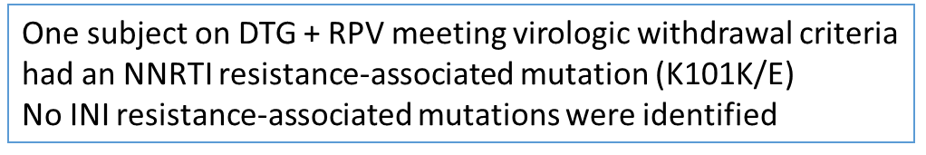
Mono & dual therapy
DTG + Rilpivirine is non-inferior to continuing ongoing ART in virologically suppressed patients
  Virologic outcomes
  Adjusted treatment difference (95% CI)ª
95
95
CAR
DTG + RPV
FDA label: For pts who have been virologically suppressed for ≥ 6 months and no history of treatment failure and no resistance to DTG or RPV
-0.2
-3.0
2.5
<1
1
5
4
Percentage-point difference
DTG + RPV is non-inferior to CAR with respect to snapshot in the ITT-E population (<50 c/mL) at Week 48
Inclusion criteria
On stable CAR >6 months before screening
1st or 2nd ART with no change in prior regimen due to VF
Confirmed HIV-1 RNA <50 c/mL during the 12 months before screening
HBV negative

Slide 18
Dual therapy with Cabotegravir IM + Rilpivirine IM as
Long-Acting Maintenance ART: 96-Wk Results (LATTE-2)
Long-Acting InSTIss
Cabotegravir: InSTIs formulated as PO tablet and for long-acting IM injection
LATTE-2: phase IIb study in which pts randomized to CAB 400 mg + RPV 600 mg IM Q4W, CAB 600 mg + RPV 900 mg IM Q8W, or CAB 30 mg + ABC/3TC 600/300 mg PO QD after induction/virologic suppression with oral CAB + ABC/3TC (N = 309)
100
94
IM CAB + RPV Q4W (n = 115)
IM CAB + RPV Q8W (n = 115)
PO CAB + ABC/3TC (n = 56)
Treatment Differences (95% CI)
80
87
84
Injectable Rilpivirine requires cold chain
Q8W IM
60
Pts, Wk 96 (%)
40
20
4
13
14
-0.6
20.5
0
0
2
2
Virologic
Success*
Virologic
Non-response
No Virologic
Data
Q4W IM
*HIV-1 RNA < 50 copies/mL.
Few drug-related AEs. At 96 wks, ~ 30% pts receiving IM injection experienced ISR 99% of ISRs mild/moderate /
AEs leading to withdrawal: Pooled Q4W/Q8W IM arms, 4%. PO arm, 2%
~ 88% of pts receiving IM CAB very satisfied to continue present treatment vs 43% receiving PO CAB
-8.4
14.4
Eron J, et al. IAS 2017. Abstract MOAX0205LB.
Margolis DA, et al. Lancet. 2017;[Epub ahead of print].
Notes:
3TC, lamivudine; ABC, abacavir; AE, adverse event; CAB, cabotegravir; ISR, injection-site reaction; RPV, rilpivirine.

Slide 19
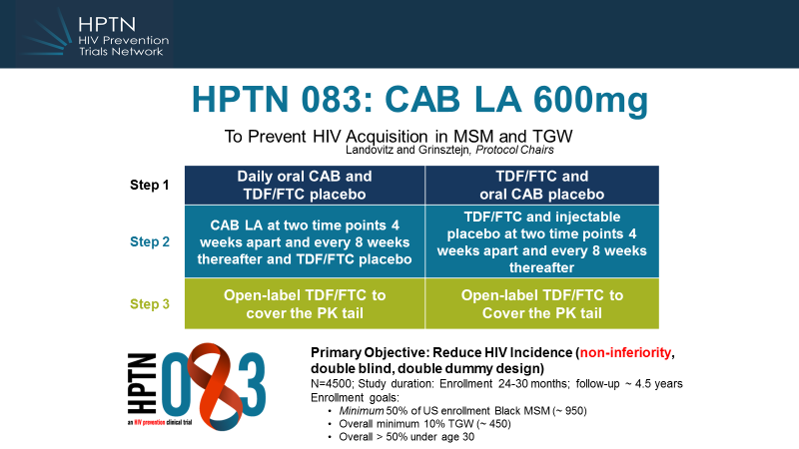
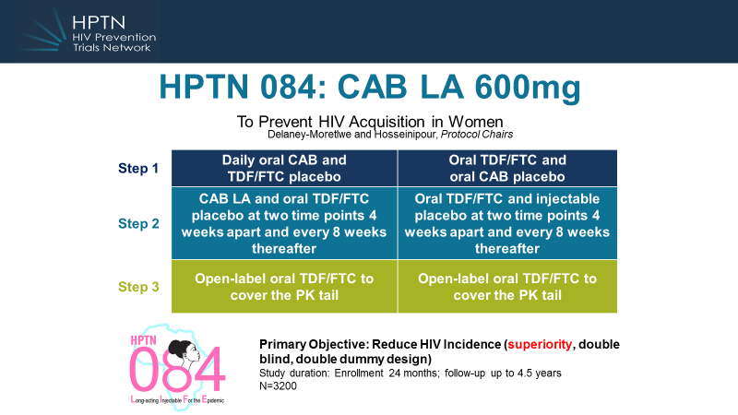
PrEP
InSTIs for PrEP?
Concern: Long half life implies a long tail after discontinuation

Slide 20
Concerns and research gaps
Pending questions
DDIs
TB
Safety in pregnant women and children
Resistance in real life
Side effects
IRIS

Slide 21
Selecting InSTIs Regimens :
Few drug interactions for RAL, DTG and BIC
DDIs
Agent(s) | Key DDIs*
All regimens | Polyvalent cation–containing supplements/medication (including antacids), Rifampin
BIC | Metformin, Rifampin (Do not use) , Dofetilide
DTG | Metformin, Dofetilide, Rifampin (Use BID)
EVG/ COBI | Statins, Rifampin (Do not use) , Dofetilide, inhaled/injected/systemic steroids, etc
RAL | Rifampin (Use BID)
* www.hiv-druginteractions.org.
Notes:
3TC, lamivudine; ABC, abacavir; CrCl, creatinine clearance; COBI, cobicistat; CVD, cardiovascular disease; DTG, dolutegravir; FTC, emtricitabine; PPI, proton pump inhibitor; RAL, raltegravir; RPV, rilpivirine; TAF, tenofovir alafenamide; TDF, tenofovir disoproxil fumarate.
References
DHHS Guidelines. October 2017.
BIC/FTC/TAF [package insert]. 2018.
DTG [package insert]. 2017.
DTG/3TC/ABC [package insert]. 2017.
DTG/RPV [package insert]. 2017.
EVG/COBI/FTC/TAF [package insert]. 2017.
EVG/COBI/FTC/TDF [package insert]. 2017.
FTC/TAF [package insert]. 2017.
FTC/TDF [package insert]. 2017.
RAL [package insert]. 2017.

Slide 22
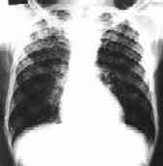
TB
INSPIRING: SAFETY AND EFFICACY OF DOLUTEGRAVIR-BASED ART IN TB/HIV COINFECTED ADULTS AT WEEK 48
Dooley et al. IAC 2018; Abstr TUAB0206
N: DTG 69
EFV 44
Virologic
success
Virologic
non response
No virologic
data
B/F/TAF BID co-administered with RIF
  AUC0-24 decreased by 61%
  Cmax decreased by 47%
  C trough decreased by 80%
  Custodio J, et al. 25th CROI; Boston, MA; 2018. Abst. 34
ITT-E population: 75% (95% CI: 65%, 86%)
Median DTG Ct during twice-daily dosing with rifampin was similar to that associated with DTG once-daily dosing without rifampin

Slide 23
InSTIs and TB: Research questions
TB
How would the BID dosing of RAL or DTG impact adherence on a STR TB regimen?
What about DDIs with MDR-TB drug regimens? (bedaquiline, linezolid, delaminid, clofazimine, moxifloxacin)
Efficacy of Rifapentin-based TB prevention regimens when co-administred with InSTIs?

Slide 24
PW & children
Small number of first trimester ART exposures
  280 DTG/TDF/FTC
  395 EFV/TDF/FTC
Any adverse
birth outcome
Severe adverse birth outcome
 | DTG/TDF/FTC (845) | EFV/TDF/FTC (N=4593)
Any Adverse Birth Outcome aRR* (95% CI) | 1.0 (0.9,1.1) | ref
Severe Birth Outcome aRR* (95% CI) | 1.0 (0.8,1.2) | ref
*Models adjusted for maternal age, educational attainment and gravida
Zash R:
IAS 2017
Abstr:MOAX0202LB 2
Notes:
Here are our main results. The total % of adverse birht outcomes, seen here in the lighter bars was 34% in DTG compared with 35% in EFV. In the darker bars, you can see the % of total severe adverse outcomes was 11% for both regimens. In adjusted analysis the relative risk of both any adverse and any severe adverse birth outcome was 1
Total HIV negatives 29%, TDF/FTC at conception 36%
Severe HIV negatives 10% and TD/FTC/EFV 12%(

Slide 25

InSTIs use in pregnancy
PW & children
RAL is recommended as preferred agent
EVG (either as EVG/c/FTC/TDF or EVG/c/FTC/TAF) is not recommended
DTG is considered as alternative agent
BIC: No data available regarding use of BIC in pregnancy

Slide 26
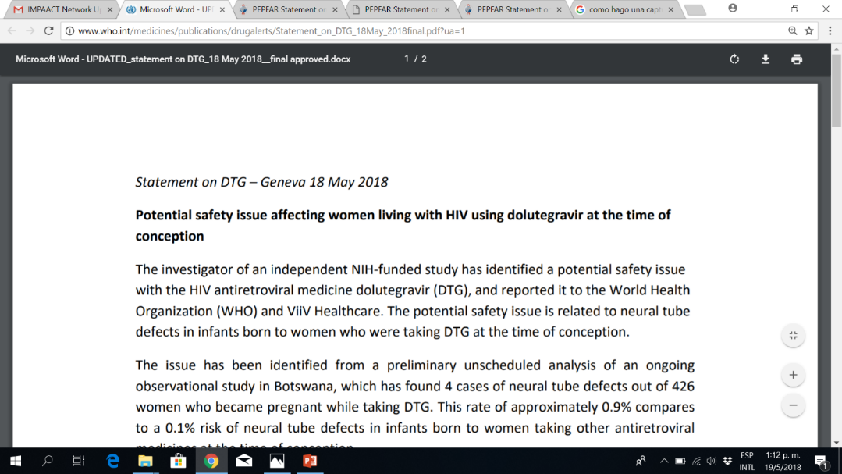
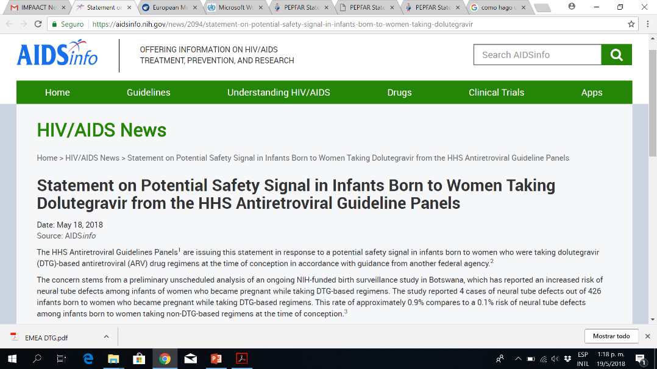

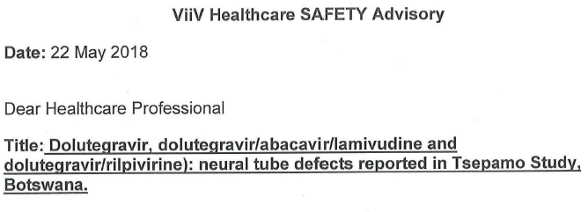
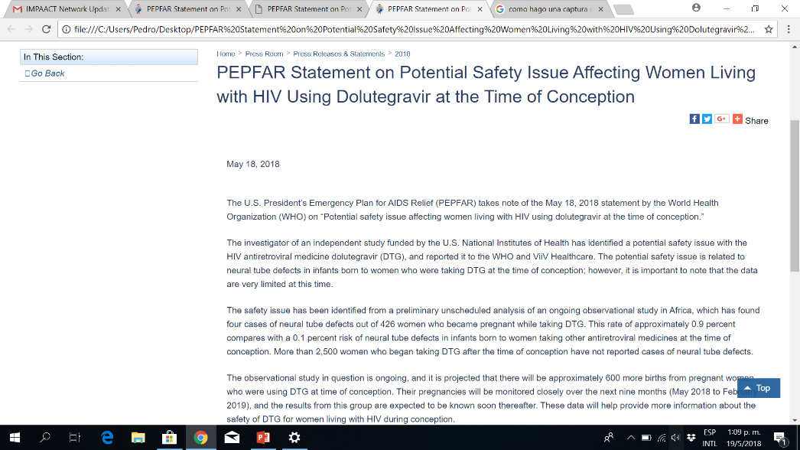

PW
The safety signal: 4 cases of NTD reported in Botswana
out of 426 PC exposures*
*0.94% vs 0.12% in non-DTG exposed newborns
**Now 4 cases out 596 exposures: 0.67% (Zash, IAC 2018)

Slide 27
PW
NTDs: This is not the first time we are concerned
about the potential relationship with ARV drugs

Slide 28
So, what to do?
PW
Let’s be cautious
Is this relationship true or just a coincidence?
If true, what are the implications for other drugs in class?
Are other factors involved (i.e. folic acid deficiency?)
More data from different registries, focusing on periconceptional exposure to DTG are needed
FDA: Providers should weigh the benefits &risks of DTG when prescribing ARVs to women of childbearing age. Alternative ARVs should be considered. If the decision is made to use DTG in women of childbearing age, health care professionals should reinforce the consistent use of effective birth control.
WHO: DTG is a potential important drug to reduce MTCT. Females in child-bearing age can receive DTG with consistent and reliable contraception.
But counseling does not avoid unintended pregnancies by itself.
Programmatic decisions should balance the cost/benefit of affecting DTG rollout in countries with high HIV burden. Also equity in access have to be considered
Women need to be informed about pros and cons of the different options and have the right to make informed choices.

Slide 29
InSTIs for children:
Indication varies according to the drug, age, and weight
Children
DHHS:
RAL: Preferred > 2 years and < 6 years
Alternative > 6 years
Alternative > 4 weeks, < 2years
EVG: Preferred > 12years and > 35 Kg
DTG: Preferred > 30 Kg (EMA > 15 Kg)
BIC: No data

Slide 30
Very low rate of emergent resistance to InSTIs in clinical trials of
InSTIs + 2NRTI in treatment-naïve patients
Resistance
Treatment | Major resistance mutations detected by genotyping in treatment-naïve patients with failing therapy | Minor resistance mutations | With NRTI-associated mutations? | %9
RAL^{1,2} | Y143H/C/R N155H Q148H/K/R E92Q G140S | Multiple | Yes | 0.2 to 2.4
EVG³ | T66I E92Q N155H Q148R | Multiple | Yes | 1.1 to 2.3
DTG^{4–6} | None | None | None | 0
BIC^{7–8} | None | None | None | 0
1. Cooper et al. N Engl J Med 2008;359:355–65;
2. Rockstroh et al. Clin Infect Dis 2011;53:807–16;
3. Sax et al. Lancet 2012;379:2439–48; 4 Raffi et al. Lancet Infect Dis 2013;13:927–35;
5. Walmsley et al. J Acquir Immune Defic Syndr 2015; 70:515–9;;
6. Walmsley et al. J Acquir Immune Defic Syndr 2015;70:515–19;
7. Gallant et al. Lancet 2017];
8. Sax et al. Lancet 2017
9..White et al:Viruses 2014].

Slide 31
Research questions
How relevant are the S230R and R263K mutations (selected in DTG monotherapy studies)?*
For patients failing a NNRTI- based regimen, is it safe to switch to INSTIs without a resistance test?
In countries where pVL is not regullarly available, how risky is to promote massive switches to DTG, which could include compromised NRTI backbones?
* Pham, JID 2018

Slide 32
InSTIs-containing regimens were associated with few discontinuations due to AEs in treatment-naïve patients
Toxicity/tolerability
Discontinuations from Phase 3 studies
in treatment-naïve patients: InSTIs vs InSTIs
Study 104+111
(48 weeks)⁴
SPRING¹
(96 weeks)
Study 1490
(48 weeks)³
Study 1489
(48 weeks)²
1. Raffi et al. Lancet Infect Dis 2013;13:927–35;
2. Gallant et al. Lancet 2017 [Epub ahead of print];
3. Sax et al. Lancet 2017 [Epub ahead of print];
4. Sax et al. Lancet 2015;385:2606–15.
EVG/c/
TDF/FTC
DTG/
TAF/FTC
BICG/
TAF/FTC
BIC/
TAF/FTC
EVG/c/
TAF/FTC
DTG RAL
+ 2NRTIS
DTG/
ABC/3TC
Discontinuations from Phase 3 studies
in treatment-naïve patients: InSTIs vs PIs
Discontinuations from Phase 3 studies of
treatment-naïve patients: InSTIs vs NNRTIs
Discontinuations for AEs (%)
DRV/r +
TDF/FTC
DTG
+ 2NRTIs
DTG/
ABC/3TC
RAL +
TDF/FTC
ATV/r +
TDF/FTC
DRV/r +
2NRTIs
ATV/r
+ TDF/FTC
EVG/c/
TDF/FTC
ATV/r +
TDF/FTC
DTG/
ABC/3TC
EFV/
TDF/FTC
FLAMINGO
(96 weeks)¹
ARIA
(48 weeks)²
Study 103
(144 weeks)³
WAVES
(48 weeks)⁴
ACTG5257*
(96 weeks)⁵
EVG/c/
TDF/FTC
EFV/
TDF/FTC
EFV/
TDF/FTC
RAL +
TDF/FTC
Study 102
(144 weeks)¹
SINGLE
(144 weeks)²
STARTMRK-1
(156 weeks)³
1. Molina et al. Lancet HIV 2015; 2:e127–36;
2. Orrell et al. Lancet 2017 [Epub ahead of print];
3. Clumeck et al. J Acquir Immune Defic Syndr 2014;65:e121–4;
4. Squires et al. Lancet HIV 2016;3:e410–20;
5. Lennox et al. Ann Intern Med 2014;161:461–71.
1. Wohl et al. J Acquir Immune Defic Syndr 2014;65:e118–20;
2. Walmsley et al. J Acquir Immune Defic Syndr 2015;70:515–9;
3. Rockstroh et al. Clin Infect Dis 2011;53:807–16.

Slide 33
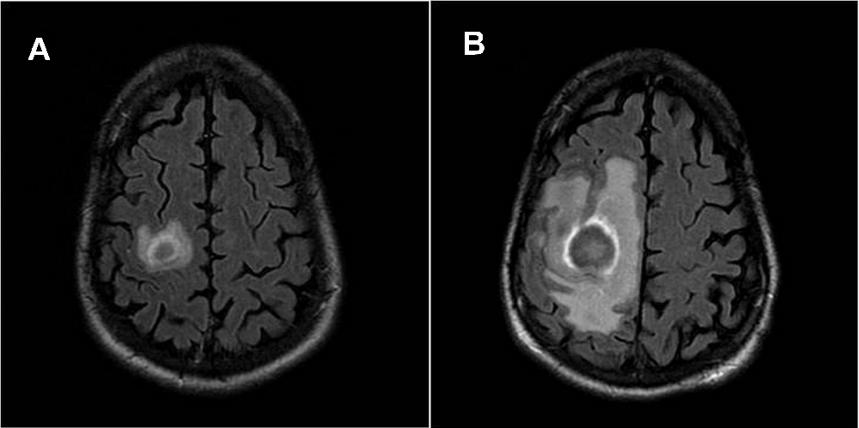
Risk of IRIS with InSTIs not confirmed in 3 RCT
IRIS
The REALITY trial (patients with CD4+ < 100 cells/mm³) assessed the effects on 24-week mortality of adding an InSTIs to a standard 3-drug regimen for 12 weeks. REALITY showed 24-week and 48-week similar mortality rates and no effect on fatal or non-fatal IRIS events. Gibb DM, et al. CROI 2018. Abstract O23.
The OPTIMAL trial evaluated the impact of first-line InSTIs on IRIS events (Patients with CD4+ < 200 cells/mm3). No significant difference in IRIS rates between InSTIs-based vs no InSTIs-based HAART. Lelievre JD, CROI 2018, Abs. 495
The INSPIRING study compared the use of dolutegravir vs efavirenz when combined with rifampicin. The authors found no difference in incidence of TB-associated IRIS or other IRIS between treatment arms. Dooley KE, et al. IAC 2018, Abstract TUAB0206

Slide 34

Incidence of fatal and non-fatal IRIS-compatible events
IRIS
0
5
1
 | Additional RAL | Standard-of-care | p
All | 89 (9.9%) | 86 (9.5%) | 0.79
TB-IRIS | 53 (5.9%) | 54 (6.0%) | 1.00
Cryptococcal-IRIS | 15 (1.7%) | 16 (1.8%) | 1.00
Other of known aetiology | 17 (1.9%) | 14 (1.6%) | 0.59
)
d
r
a
z
0
a
0
h
1
(
Y
IRIS associated to
  Lower pre-ART CD4
  Older age
  TB at ART initiation
P
0
0
1
/
e
t
a
r
0
t
5
n
e
v
E
0
0
8
16
24
32
40
48
Week since randomisation (ART initiation)
Standard
Raltegravir-intensified
Fatal/non-fatal IRIS-compatible events occurred in
89 (9.9%) raltegravir-intensified vs 86 (9.5%) standard (p=0.79)
Kityo: 25th CROI, abstr 531

Slide 35

UNPRECEDENTED SPEED IN FACILITATING ACCESS TO NEW TREATMENTS
4 years after approval of DTG, licenses through the Medicines Patent Pool and work from many other partners resulted in a combination becoming widely available in a large number of developing countries from multiple quality assured suppliers
August 2013: DTG approved by US FDA
June 2016 WHO guidelines introduce DTG in 1st line
Sept 2017
Several partners announce price of US$75 pppy for TLD combination
2013
2014
2015
2016
2017
April 2014: MPP license with ViiV Healthcare. Covers countries home to 94% of people with HIV in LMICs
August 2017: First new DTG-combination from MPP licensee approved by USFDA

Slide 36
Access
**
** Some midddle-income countries also recommend other InSTIs
Granich et al: IAC 2018, Abstr WEAD0304

Slide 37
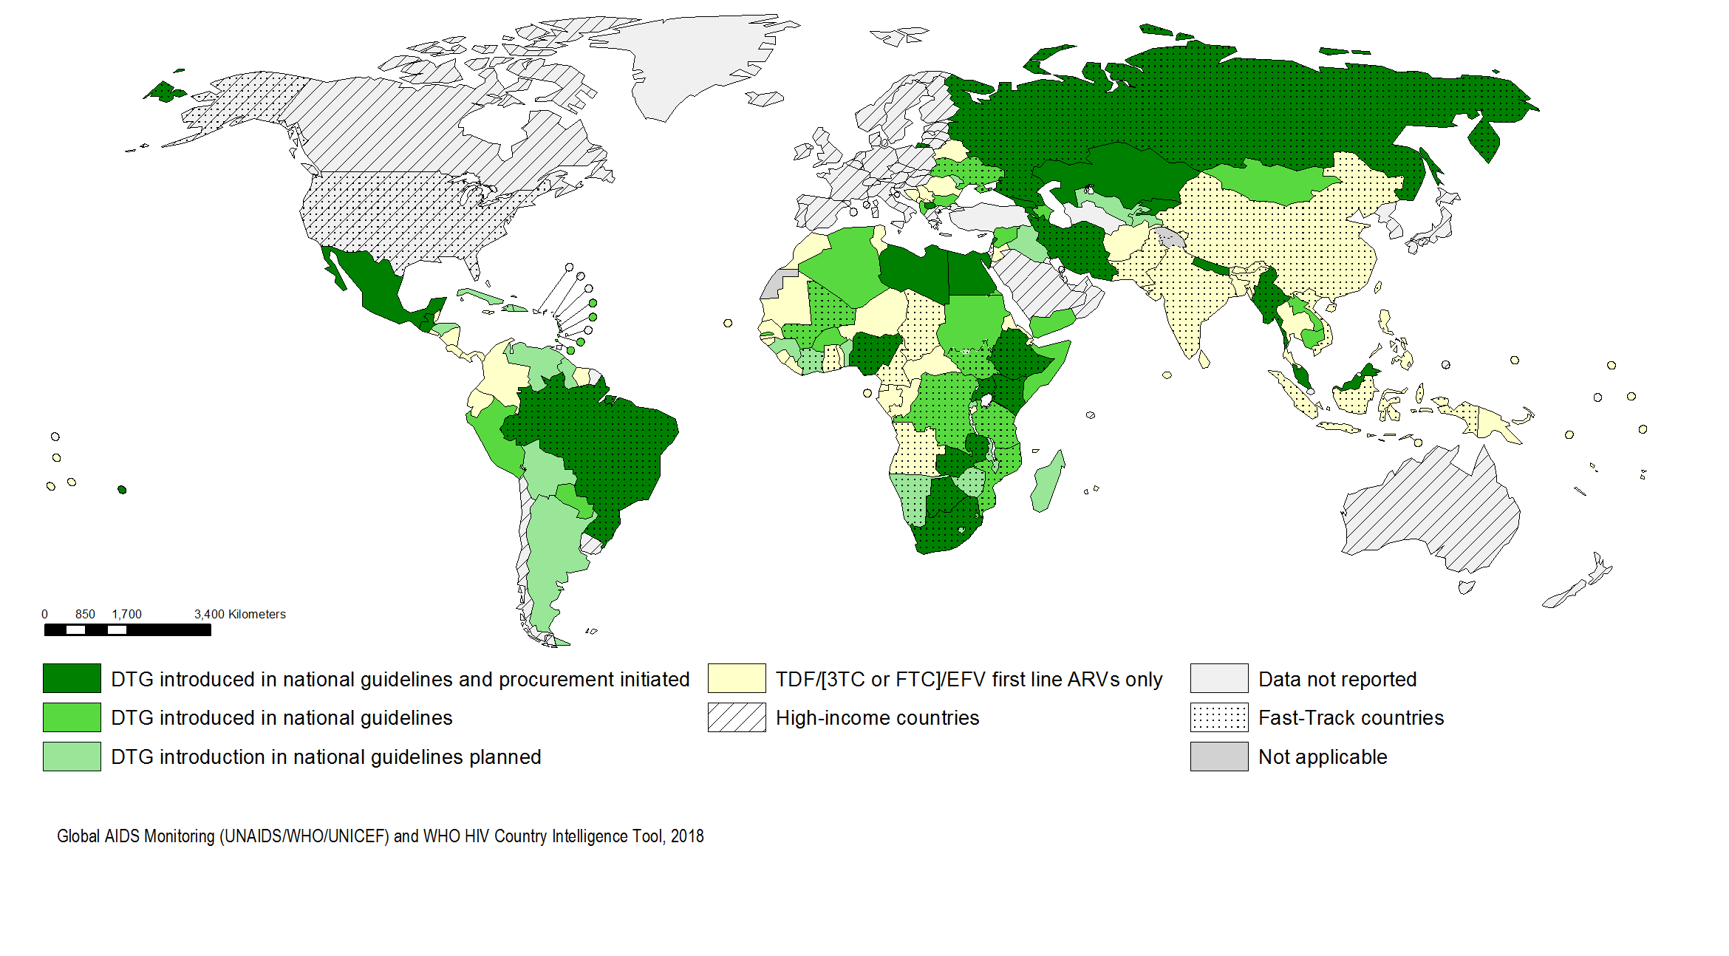
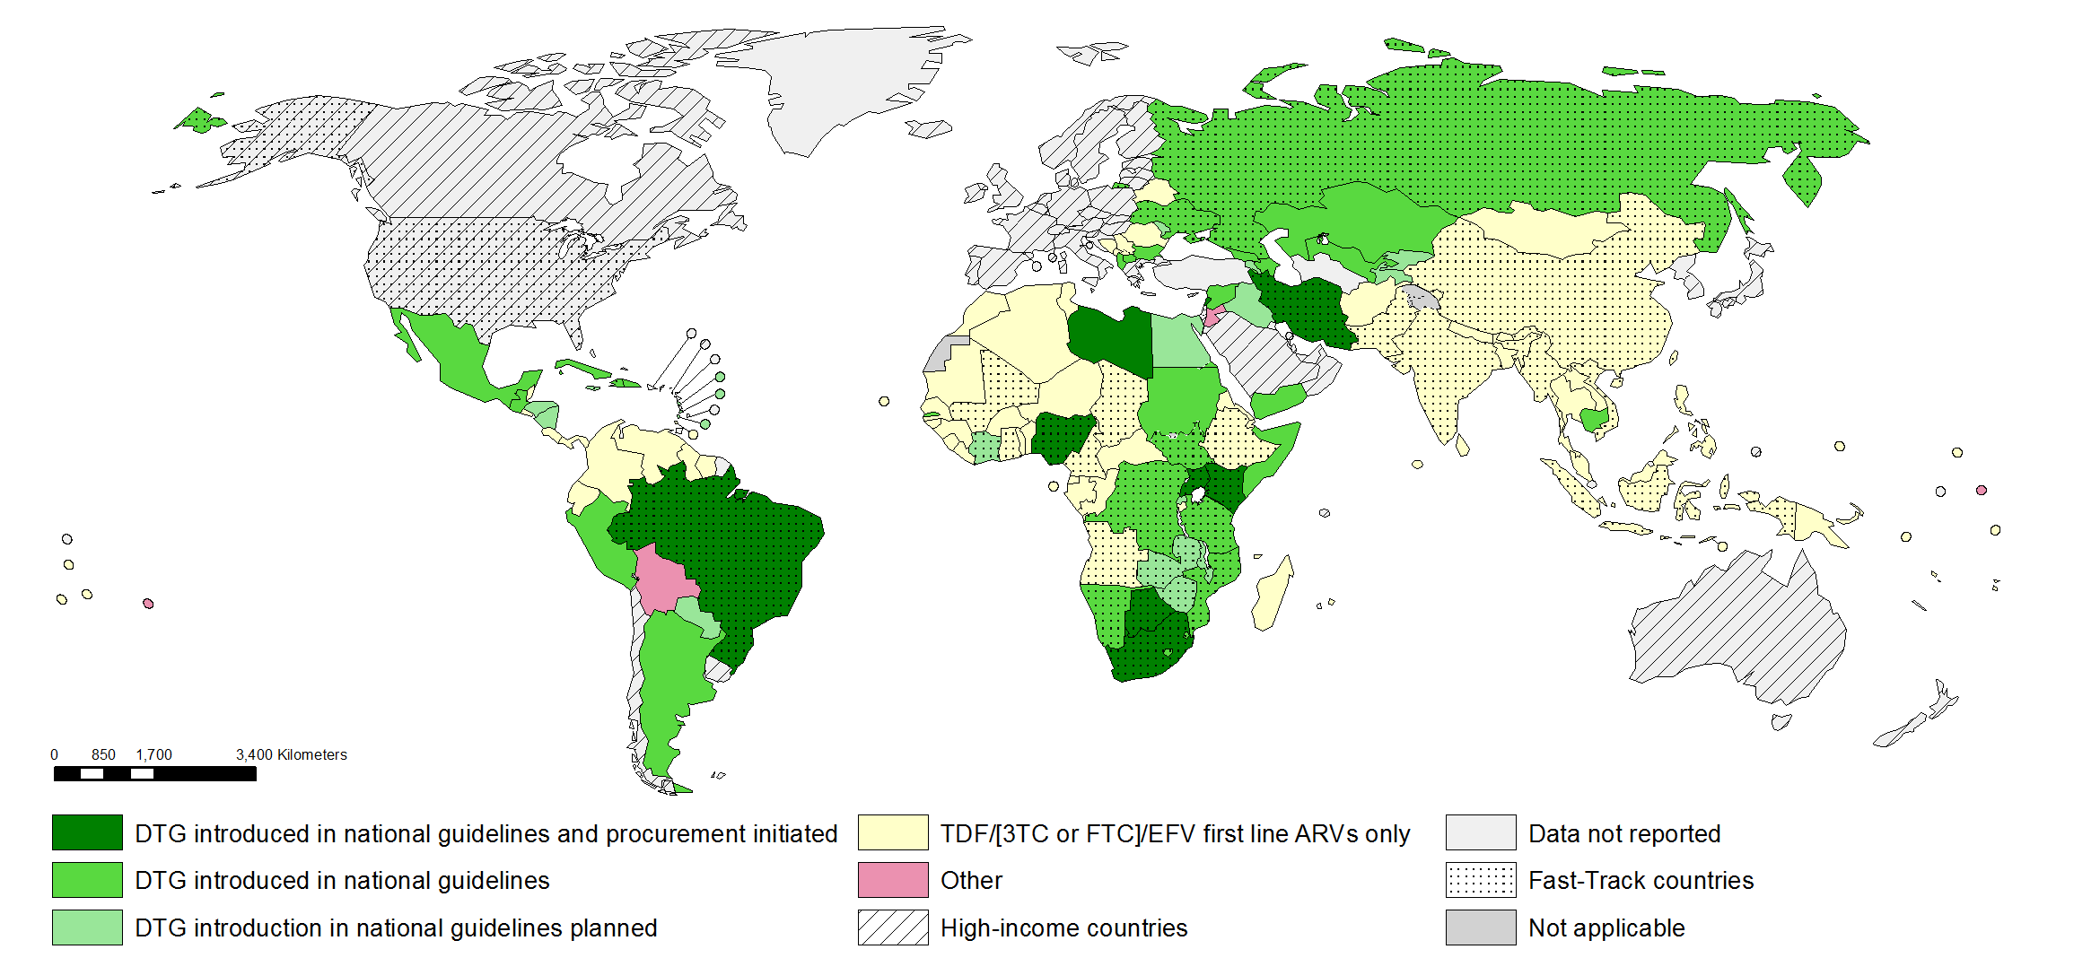

Access
Progress in transition to Dolutegravir (DTG) as a preferred first line ARV regimen in LMIC
Some middle-income countries include also other InSTIs in first line
98 (51%) of LMIC are making shifts to DTG containing regimens
Modified from Meg Doherty
Notes:
87 countries (45%) of LMIC adopted TDF/[3TC or FTC]/EFV as the preferred first-line therapy, whereas an additional 98 (51%) of LMIC are making shifts to DTG containing regimens (measured as composite indicator of countries that have introduced or are introducing DTG in their guidelines and procurement of DTG has been initiated).
# LMIC JULY 2018
Data not reported 5
DTG introduced in national guidelines 26 DTG introduced in national guidelines and procurement initiated 24
DTG introduction in national guidelines planned 21
TDF/[3TC or FTC]/EFV first line ARVs only 63
Grand Total 139
In November 2017: 72% of LMIC adopted TDF/3TC or FTC)/EFV as the preferred first-line therapy, whereas an additional 40% of LMIC are making shifts to DTG containing regimens.

Slide 38
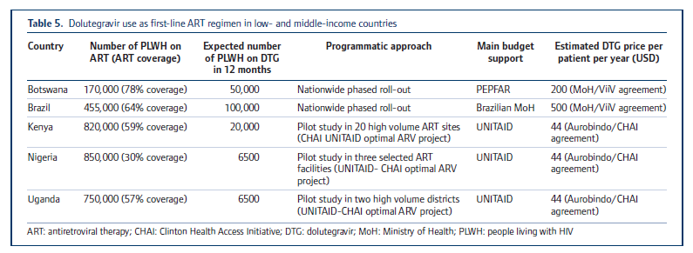
Rollout of DTG in LMIC
Access
Dorward et al. Lancet HIV 2018. Published Online June 5, 2018
Brazil has now over 112,000 patients on DTG (Schwartz Benzaquen, personal communication)
South Africa: 5 million patients expected to be on DTG by the end of 2019 (Venter, personal communication)

Slide 39
Access
Philips et al:

Slide 40
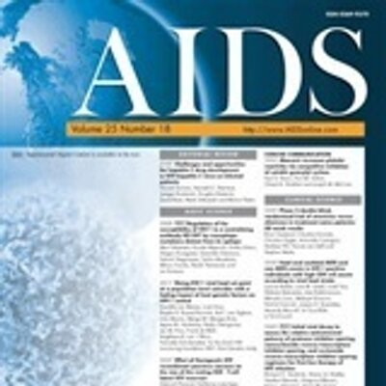
Access
Vitoria M et al: AIDS 2018

Slide 41
Access
Summary of pending questions

Slide 42
Conclusions
We are moving towards the integrase world, as InSTIs are non inferior (or superior) to NNRTI and PI based regimens, in naive, virologically suppressed and viremic patients.
Four options available, differences based on experience, STR availability, DDIs, tolerability, genetic barrier and affordability
Resistance is not a major issue, so far
InSTIs shown effective as anchor drugs in dual therapy regimens. Durability?
Not recommended as monotherapy
DDIs and adherence concerns when used with TB drugs
Women in child-bearing age: Caution and effective contraception recommended with DTG. Risk benefit compared to other options to be considered. Women to make informed choices.
Unprecedented roll-out in low income countries. But uncertainties remain.
Implementation challenges (and cost in middle-income countries) to be solved

Slide 43
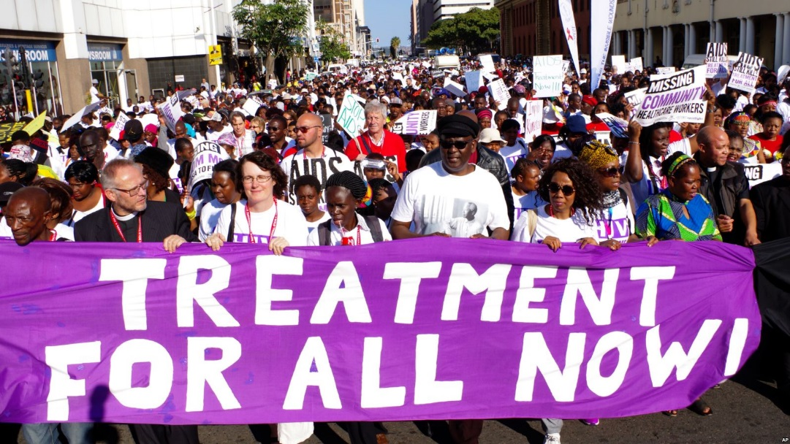
My vision:
InSTIs-based therapy will help us to succeed in our goals!

